Slide 1
MODULE 6
CAMPBELLSVILLE UNIVERSITY
GROUP 8 : CEREAL KILLERS
INSTRUCTOR: JOHN KENNEY

Slide 2
Abhinav Singarayakonda Tirumala - 559189
Srilatha Arigapudi - 558162
Sai Kiran Nagala - 557876
Kiran Thota – 558042
Mahender Pathipaka – 557277
Raju Benjarapu – 554386
Sairaj Chintala – 557570
Veera Yerajerla – 557482
Vinay Penikalapati – 555888

Slide 3
Networking and Social Capital
Definition:
Social capital is sum of real and potential resources involved within, available and derived from the social network relationships provided by individuals or a group.
Social capital is also linked with various groups and teams outcomes by knowledge sharing, learning, transaction costs, reduction in time requirements and reduced redundancy.

Slide 4
In our work we seek to understand the extent to which modern social networking systems can help individuals in their daily interactions through various means and support.
In particular, we present a study that examines the relationship between individuals’ social network structure on Facebook and social capital.

Slide 5
Teams and Social Networks
The overall performance of the groups and the team members in the organizations depends on their quality of work and inter relations of the group members and execution of the work.
The quality of the social networks also considered as three common necessary features, communication, social integration and coordination within the group gives the effective work as an outcome from the team.
Social integration is itself acts as a effective performance within the group
Notes:
Both experience and inheritance impact human behavior.
Human behavior influences the way of developing social experience and situations in the context of inherited genetic potential.
Leaders need a certain level of enthusiastic insight to verify the need to approve or legalize themselves.
The problematic situation for the living human being, hormonally and neurologically, is to secure itself.

Slide 6
Social Capital
To find out the value of social networks from team performance, the amount of integration, communication, relationship or connectedness within the team members, closeness is summated into social capital.
Social capital is productive, making possible of certain goals that have been left as un attended as would not be possible.
Notes:
Social capital makes it possible directly by following the three common performances noted earlier as a key within the team members in the group.

Slide 7
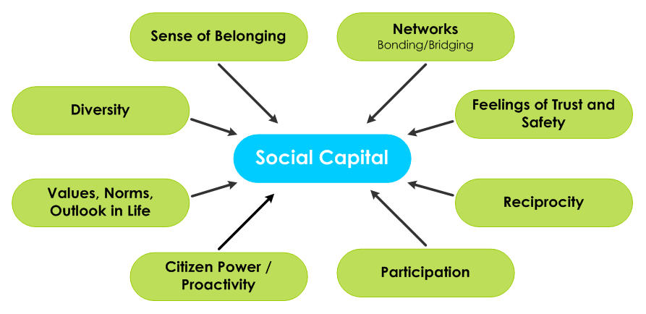

Slide 8
Categories and Subject Descriptors
Social networks analysis,
ego networks,
social capital,
personality traits.

Slide 9
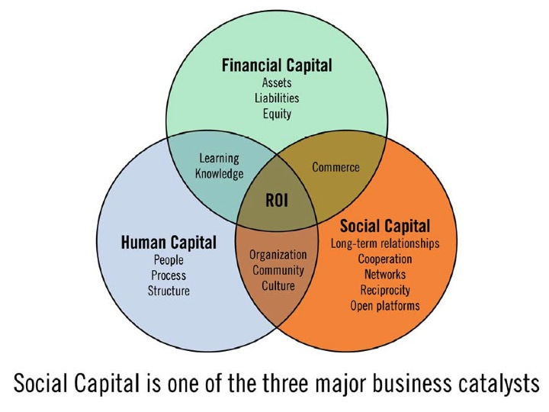

Slide 10
Defining Human capital
Human Capital presents the unique form of capital that has the ability to put other forms of capital – tools, infrastructure like man made capital and land natural capital in motion to produce goods & services and thus to create new values.
The value of Human Capital depends on the previous investments in developing new and useful knowledge, skills and attitudes (Abrigo, M. R. M., 2018).
It requires continuing investment in developing new knowledge and skills.

Slide 11
Continue..
Academia performs a widespread position in constructing new human capital.
However its effectiveness relies upon on many different factors, together with political system and lifestyle.
that could inspire or suppress vital questioning and creativity – the unlimited capacity of this capital to create values (Takashima, R.2018).

Slide 12
Classifying social capital
There is positive and negative Social Capital.
Positive Social Capital create economic advantages that are major forces for clustering
Negative Social Capital could start developing when there are efforts to limit membership in clusters and cultivate insularity or lock-in (Allen, D. G.2018).

Slide 13
Continue..
Effective networking will lead to wider get entry to resources and know-how that can be shared with like-minded primary healthcare practitioners (Zhang. s., 17).
It is possible when it comes to taking ahead properly practice that has been evolved in a single vicinity and that might be beneficial in another placing.
This could, in flip, gain otherwise remoted practitioners and healthcare corporations in which there may be a smaller critical mass of expertise(Allen, D. G.2018).

Slide 14
Continue..
Networks have different purposes like highlight the value of networks that provide supportive relationships for people as they progress through their careers (Takashima, R.2018).
The assist with career development and progression, and those that improve the workplace and patient care.

Slide 15
Continue..
Human capital models of migration.
The focus is on the individual's decision to move and that this decision is conditional upon the return(Rosado-Solomon, E. H., 2018).
It expects to receive from moving in contrast to what is expected from staying.

Slide 16
OUTCOMES for Social Capital.
Human Capital strategies that advance the business objectives of the organization.
Effective and appropriate assignment of employees.
Selection, development and retention of high quality employees(park., D. 2018)
Strategic human capital plan strategic business plan alignment.

Slide 17
Model of social capital formation
Adopting a definition of social capital that draws on a micro-level explanation that emphasizes the role of social networks allows social capital to be measured separately from outcomes.
Social capital as networks has not been formally modeled until now – model allows measurable aspects of network formation to be clearly defined (Takashima, R.,2018).

Slide 18
Continue..
Model recognizes relationships can be both beneficial and costly and that individuals will sever relationships according to cost and benefit(cheng.,C.S.A, 2018)
As network links are formed individuals begin to accumulate social capital (park, D., 2018).

Slide 19
Net benefit of a connection function of six factors(Lee., 2018)
Presence of a pairwise link.
Value of the link in the current period (Zhang, N., 2017).
Social capital in the link.
Reputation of contacts.
Congestion of contacts.
Cost of linking (Zhang, N., 2017).

Slide 20
Types of social capital enhanced
Bonding social capital tends to be inward looking and reinforces homogenous groups.
Bridging social capital refers to relations with distant friends and associates (Takashima, R., 2018).
Linking social capital refers to relations between different social strata in a hierarchy where power, social status and wealth are assessed by different groups(Zhao, S. 2017).

Slide 21
References..
Cheng, C. S. A., Wang, J., Zhang, N., & Zhao, S. (2017). Bowling Alone, Bowling Together: Is Social Capital Priced in Bank Loans? Journal of Accounting, Auditing & Finance, 32(4), 449–479. https://doi.org/10.1177/0148558X17724890
Takashima, R. (2018). Education and the Public Goods Type of Social Capital: Are the Well Educated Free Riding in the Provision of Public Goods? Journal of Economic Issues (Taylor & Francis Ltd), 52(3), 770–794. https://doi.org/10.1080/00213624.2018.1489626

Slide 22
Referencs..
Methot, J. R., Rosado-Solomon, E. H., & Allen, D. G. (2018). The Network Architecture of Human Captial: A Relational Identity Perspective. Academy of Management Review, 43(4), 723–748. https://doi.org/10.5465/amr.2016.0338
Abrigo, M. R. M., Lee, S.-H., & Park, D. (2018). Human Capital Spending, Inequality, and Growth in Middle-Income Asia. Emerging Markets Finance & Trade, 54(6), 1285–1303. https://doi.org/10.1080/1540496X.2017.1422721

Slide 23
references
Burt, R. S. (1995). Structural Holes: The Social Structure of Competition. Harvard University Press.
Burke, M., Kraut, R. & Marlow, C. (2011). Social capital on Facebook: Differentiating uses and users. Conference on Human Factors in Computing Systems CHI 2011, 571-580, ACM.
Ellison, N., Steinfield, C., & Lampe, C. (2007). The Benefits of Facebook "Friends:” Social Capital and College Students’ Use of Online Social Network Sites. Journal of ComputerMediated Communication, 12(4), 143-1168.
.

